Slide 1

Data Analysis Of Lung Cancer
Presented by
Sridhar Yalavarthi
Leena Chowdary K
Notes:
We designed this template so that each member of the project team has a set of slides with its own theme. Members, here’s how you add a new slide to just your set:
Mark where you want to add the slide: Select an existing one in the Thumbnails pane, click the New Slide button, then choose a layout. The new slide gets the same theme as the other slides in your set.
Careful! Don’t annoy your fellow presenters by accidentally changing their themes. That can happen if you choose a different theme from the Design tab, which changes all of the slides in the presentation to that look.

Slide 2
Agenda / Topics
Introduction
Project Objectives
Data
Design Overview
Conclusion

Slide 3
Introduction
Lung cancer is a serious and prevalent health condition that affects millions of people around the world. The high mortality rate associated with lung cancer makes it a significant public health concern. Therefore, there is a great deal of interest in understanding the factors that contribute to the development and progression of this disease.
Data analysis plays an important role in this effort, as it can help researchers and clinicians identify patterns and trends in large amounts of data that might not be immediately apparent to the human eye. By analyzing data related to lung cancer, researchers can identify risk factors, potential causes, and effective treatment strategies.

Slide 4
In particular, data analysis can help identify potential correlations between specific risk factors and the incidence of lung cancer. For example, researchers might look at data related to smoking, environmental pollutants, or genetic factors to see if there is a statistically significant relationship between these factors and the development of lung cancer.
Overall, the motivation behind data analysis of lung cancer is to better understand the disease and develop more effective strategies for prevention, diagnosis, and treatment. By analyzing large amounts of data, researchers can gain new insights into the underlying causes and risk factors associated with lung cancer, which can ultimately lead to better outcomes for patients.

Slide 5
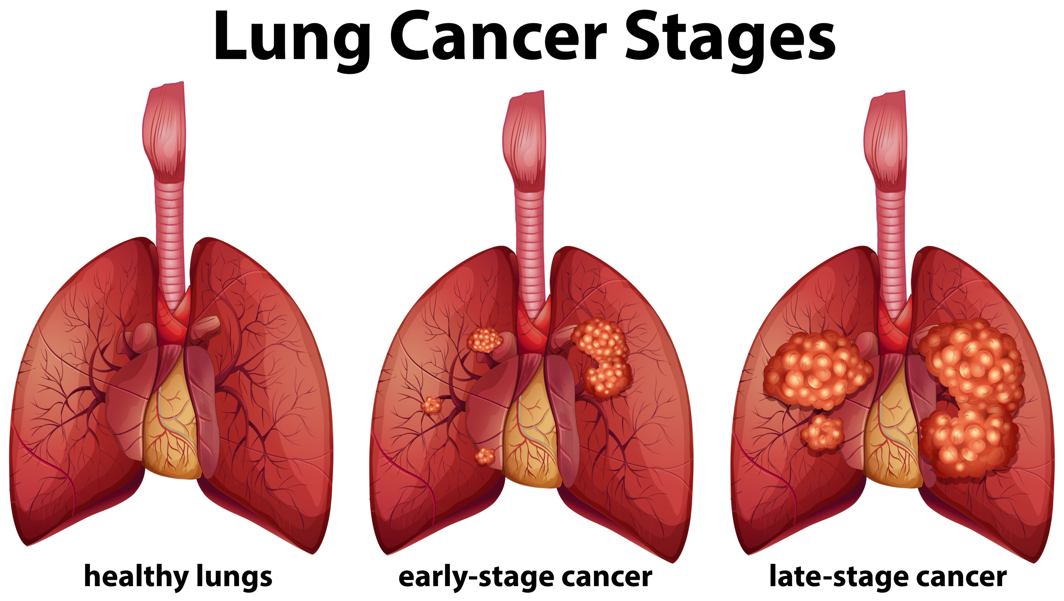
Stages Of Lung Cancer

Slide 6
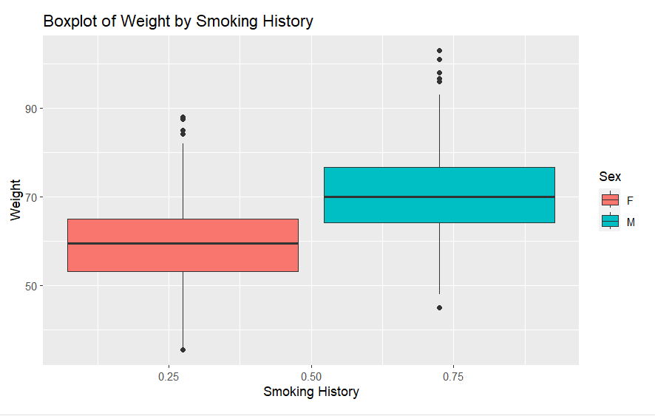
Stages of Lung Cancer
We have 3 stages of cancer(TNM)
T Stage: This refer to the size and extend of the main tumor. Tumor size is typically categorized using numerical values, such as T1, T2, T3, or T4, with higher numbers indicating larger tumors.
N Stage: This stage refers to whether cancer has spread to nearby lymph nodes, which are part of the body's immune system.
M Stage: This refers to whether the cancer has spread to distant organs or tissues in the body.

Slide 7
Project Objectives
To analyze and interpret data related to lung cancer, including patient demographics, clinical history, and treatment outcomes.
To identify potential risk factors and patterns associated with lung cancer, such as smoking history, environmental factors, and genetic predisposition.
To develop predictive models for lung cancer risk, diagnosis, and treatment response, using machine learning and statistical methods.
To assess the effectiveness of different treatments for lung cancer, including chemotherapy, radiation therapy, and surgery, and identify factors that influence treatment success.
To provide insights and recommendations for improving lung cancer diagnosis, treatment, and prevention, based on the findings of the data analysis.
Overall, the objective of the data analysis of lung cancer is to improve our understanding of this disease and provide valuable information for healthcare professionals, researchers, and policymakers to make informed decisions and develop effective strategies for lung cancer prevention, diagnosis, and treatment.

Slide 8
Data
Patient data: This may include demographic information, medical history, smoking history, family history of cancer, imaging data, pathology reports, and treatment history.
Clinical trial data: This may include data from clinical trials of new drugs, treatments, and interventions for lung cancer.
Patients-based data: This may include data from large-scale epidemiological studies and population health surveys that can provide insights into the prevalence and incidence of lung cancer and associated risk factors.
Electronic health record data: This may include data from electronic health records that can be used to identify patient cohorts, monitor treatment outcomes, and facilitate data linkage and sharing.
The choice of data sources for a Data Analysis Of Lung Cancer may depend on the research question, the availability of data, and the analytical methods used. For example, some studies may focus on identifying new genetic and molecular biomarkers of lung cancer using genomic sequencing data, while others may focus on developing predictive models for lung cancer risk based on patient demographic and environmental data. Regardless of the specific data sources used, it is important to ensure that the data are accurate, reliable, and properly de-identified to protect patient privacy.

Slide 9
Design Overview
Data Collection: Gather and consolidate relevant data on lung cancer from different sources such as electronic health records, cancer registries, clinical trials, and public health surveys.
Data Cleaning: Prepare the data for analysis by checking for completeness, accuracy, and consistency, and correcting any errors or inconsistencies in the data.
Exploratory Data Analysis: Perform descriptive statistics and visualizations to gain insights into the distribution, trends, and patterns in the data, and identify potential outliers and data quality issues.
Feature Engineering: Extract relevant features from the raw data and create new features that capture important information about lung cancer, such as tumor size, stage, histology, biomarkers, and patient characteristics.
Modeling and Analysis: Apply statistical and machine learning techniques to the data to develop predictive models and inferential analyses that address specific research questions, such as predicting lung cancer risk, diagnosing the disease, assessing treatment outcomes, or identifying risk factors.
Model Evaluation: Evaluate the performance of the models and analyses using appropriate metrics and validation techniques, such as cross-validation, and assess their robustness and generalizability.
Interpretation and Reporting: Interpret the findings of the data analysis in the context of the research questions and hypotheses, and communicate the results to stakeholders through visualizations, reports, and presentations.

Slide 10
Testing Methods
T-Test: It is one of the most common test used in statistics to compare the means of two groups.
Chi-square Test: Chi-square is a statistical method which is used to determine whether the two categorical variables have a significant correlation between them.

Slide 11
Algorithms
Logistic Regression: R has a built-in function called "glm" that can be used for logistic regression. This function allows for the modeling of binary outcomes, such as lung cancer diagnosis, with multiple predictor variables.
Random Forest: The "Random Forest" package in R can be used for building random forest models. This package allows for classification and regression tasks, and can be used for predicting lung cancer risk, survival, or treatment response.
Support Vector Machine (SVM): The "e1071" package in R provides functions for SVM modeling. SVM can be used for lung cancer diagnosis, tumor classification, or risk prediction.
Neural Networks: R has several packages that can be used for neural network modeling, such as "neuralnet" and "caret". These packages can be used for lung cancer diagnosis, treatment response prediction, or identifying genomic biomarkers.
Clustering: The "cluster" package in R provides functions for various clustering algorithms, such as k-means, hierarchical clustering, and spectral clustering. Clustering can be used for lung cancer subtype identification, patient stratification, or drug discovery.

Slide 12
Timelines
Define the research question and obtain necessary approvals (4-8 days)
Data collection and preprocessing (8-12 days)
Data exploration and visualisation (4-8 days)
Statistical analysis (10-12 days)
Interpretation and inference (4-8 days)
Validation and replication (4-8 days)
Reporting and dissemination (4-8 days)

Slide 13
Conclusion
In conclusion, data analyses of lung cancer have helped improve our understanding of this disease and have led to the development of effective treatment options. However, lung cancer remains a major health problem, and efforts to prevent and detect this disease early are crucial for improving outcomes for patients.

Slide 14
References
"Data analysis of lung cancer in the United States: a focus on racial and ethnic disparities." By Lathan C, Spector L, Wong S, et al. Journal of Thoracic Oncology. 2016; 11(10): 1647-1658.
"Big Data Analytics for Lung Cancer Management." By Nair B, Cortes J, Karachaliou N, et al. American Society of Clinical Oncology Educational Book. 2019; 39: e79-e86.
"Machine learning for lung cancer prognostication: a retrospective multi-cohort radiomics study." By Zhang L, Fried D, Fave X, et al. PLoS Medicine. 2018; 15(11): e1002711.
"Genomic and transcriptomic features of response to immune checkpoint inhibitors in advanced non-small cell lung cancer." By Skoulidis F, Goldberg M, Greenawalt D, et al. Cancer Cell. 2018; 33(4): 588-602.
"The genomic landscape of small cell lung cancer: recent advances and future perspectives." By George J, Lim J, Jang S, et al. Journal of Thoracic Oncology. 2020; 15(1): 19-33.
"Analysis of Lung Cancer Data: An Overview." By Stanciu D, Gheorghiu D, Alexandru A, et al. Diagnostics. 2021; 11(2): 312.

